Slide 1

Helper Features
Kristine Middlemiss, Developer Consultant
Autodesk Developer Network (ADN)

Slide 2

Agenda
API Command Utilities
Error Handling and Debugging
DAG Hierarchy

Slide 3
Utilities API: MGlobal
Query and set global settings (time, z-up, selection masks, etc..)
Query what is selected or highlighted
Display command warnings and errors
Interaction with script languages

Slide 4
Utilites API: MGlobal
Query and set global settings (time, z-up, selection masks, etc..)
MGlobal::mayaState(MStatus * returnStatus)
MGlobal::viewFrame ( const MTime & time )
MGlobal::setSelectionMode ( MGlobal::MSelectionMode mode)
MGlobal::setYAxisUp (bool rotateView)
Etc…

Slide 5
MGlobal & Selection List
MSelectionList: class representing a list of MObjects
Used for more than just what is selected, e.g.
Highlight list
Query / Modify list membership
MItSelectionList:class for iterating over the items in an MSelection list. A filter can be specified so that only those items of interest on a selection list can be obtained.
MGlobal::getActiveSelectionList(MSelectionList &dest);
MGlobal::getSelectionListByName ( const MString & name, MSelectionList & list )
MGlobal::setActiveSelectionList( const MSelectionList & src, MGlobal::ListAdjustment )

Slide 6
MGlobal Selection
MGlobal::select ( const MDagPath & object, MGlobal::ListAdjustment listAdjustment )
add an object to the active selection list without creating an MSelectionList first
MGlobal::selectByName(const MString & name, MGlobal::ListAdjustment listAdjustment )
finds all objects matching a pattern and adds them to the active selection list
MGlobal::setActiveSelectionList ( const MSelectionList & src, MGlobal::ListAdjustment )
Set the active selection list. The selection items on the given list will update the contents
of the active selection list as indicated by the listAdjustment parameter.
MGlobal::selectCommand ( const MSelectionList & src, MGlobal::ListAdjustment )
Set the active selection list, by calling the built in Maya select command
MStatus MGlobal::selectFromScreen ( const short & x_pos, const short & y_pos, MGlobal::ListAdjustment, MGlobal::SelectionMethod )
Perform click-pick type selection. If an object intersects the click point then it is
selected according to listAdjustment.

Slide 7
Utilities API: MGlobal
Display error/warning messages or general information to the user for custom command
void MGlobal::displayInfo ( const MString & theMessage )
void MGlobal::displayWarning ( const MString & theWarning )
void MGlobal::displayError ( const MString & theError )

Slide 8
Utilities API: MGlobal
Execute MEL script:
MGlobal::executeCommand(const MString &command)
MGlobal::sourceFile
Execute Python Command:
MGlobal::executePythonCommand (const MString &command)
# execute mel command to create a nurbs sphere
OpenMaya.Mglobal.executeCommand( "sphere" );
# execute the specified mel script OpenMaya.MGlobal.sourceFile( "C:\\MyScripts\\testScript.mel" );
#execute python command to create a poly cube OpenMaya.Mglobal.executePythonCommand (“polyCube( sx=10, sy=15, sz=5, h=20 )”)

Slide 9
Error checking: MStatus
We have removed the MStatus class. Python exceptions must be used instead of MStatus. See previous examples.
Maya API class for status codes:
OpenMaya.MStatus.kSuccess - The operation was successful
OpenMaya.MStatus.kFailure - The operation failed
OpenMaya.MStatus.kUnknownParameter - Returned by MPxNode::compute for unrecognised plugs

Slide 10
OpenMaya Status Codes
Python API does not contain MStatus
Any method that would have returned a non-success
MStatus will raise an exception instead
Provides error checking that is more natural in Python
try:
mplugin.registerNode( kPluginNodeTypeName, sineNodeId,
nodeCreator, nodeInitializer )
except:
sys.stderr.write( "Failed to register node: %s" %
kPluginNodeTypeName )
raise

Slide 11
OpenMaya.kUnknownParameter
One gotcha with MStatus codes as exceptions
Some DG routines return MStatus::kUnknownParameter
(e.g. compute)
In Python, this DOES NOT map to an exception
MStatus::kUnknownParameter maps to the Python constant maya.OpenMaya.kUnknownParameter

Slide 12
OpenMaya.kUnknownParameter
def compute(self,plug,dataBlock):
if ( plug == sineNode.output ):
dataHandle = dataBlock.inputValue( sineNode.input )
inputFloat = dataHandle.asFloat()
result = math.sin( inputFloat ) * 10.0
outputHandle = dataBlock.outputValue( sineNode.output )
outputHandle.setFloat( result )
dataBlock.setClean( plug )
return maya.OpenMaya.kUnknownParameter

Slide 13
DAG (Directed Acyclic Graph)
DAG Nodes are just DG Nodes!
Parenting are not dependency graph connections
DAG hierarchy
Node types containing transformation info:
joints (MFn::kJoint)
transforms (MFn::kTransform)
Other typical node types in a skeletal hierarchy:
shapes (nurbs, polys, …)
locators (MFn::kLocator)
Ik (MFn::ikHandle, MFn::ikEffector)

Slide 14
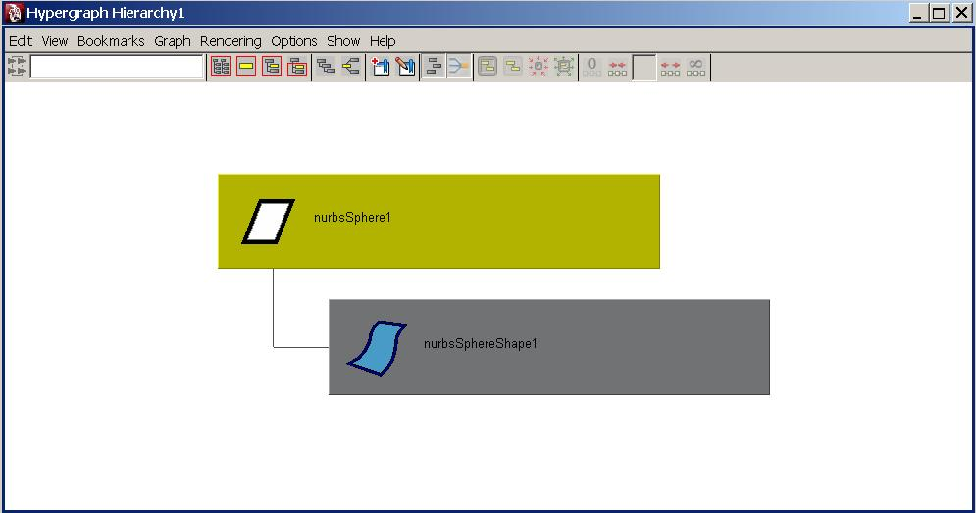
DAG Hierarchy
An Example: sphere

Slide 15
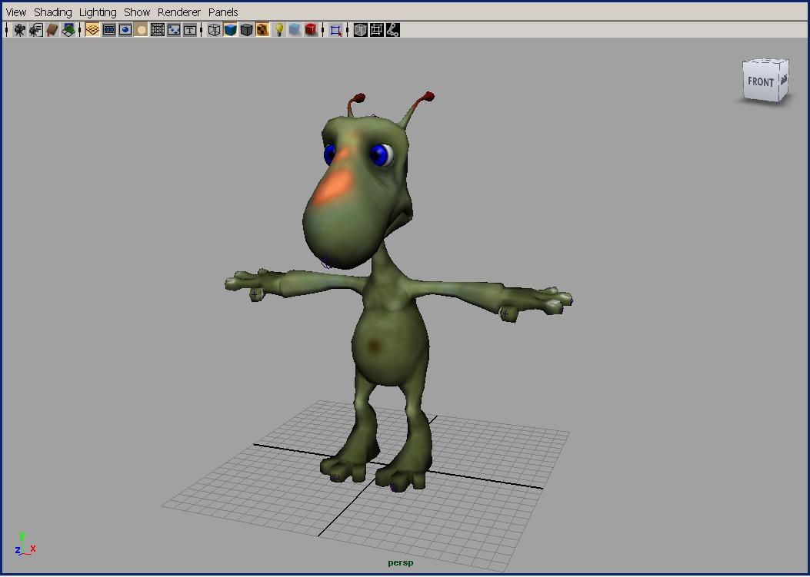
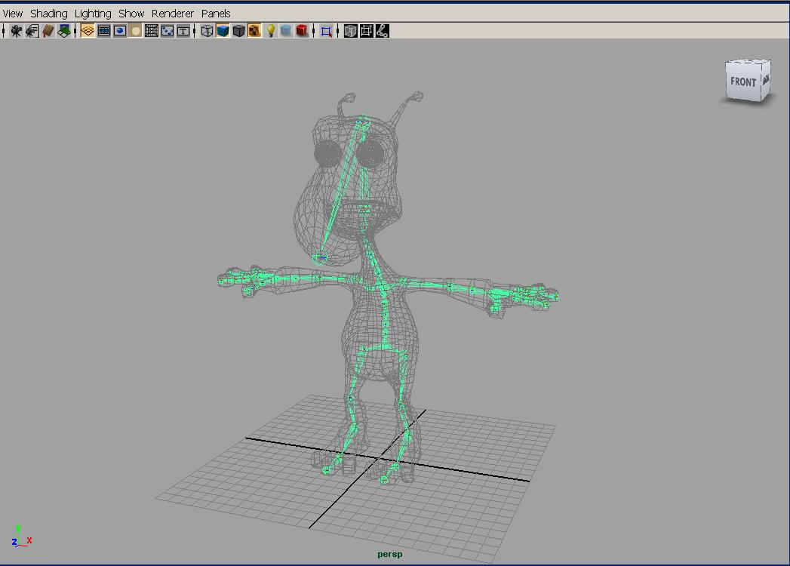
DAG Hierarchy
A more complex example: skeleton hierarchy

Slide 16
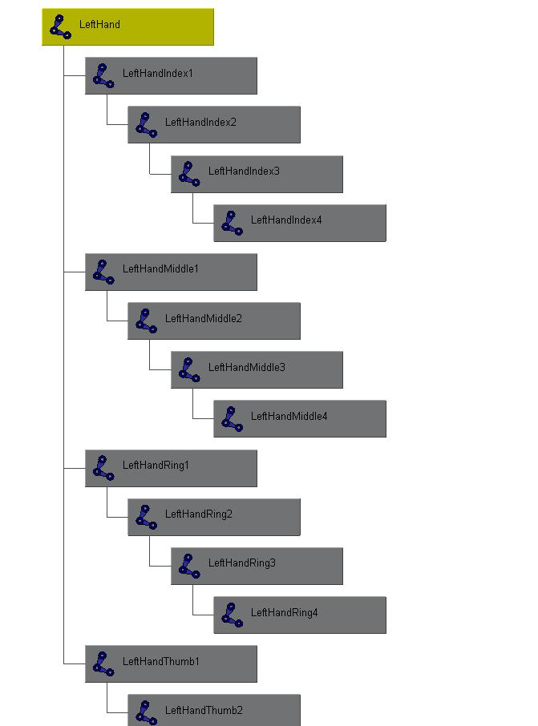
DAG Hierarchy
A more complex example: skeleton hierarchy
hip
spine
shoulder
arm
hand

Slide 17
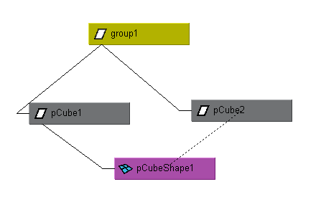
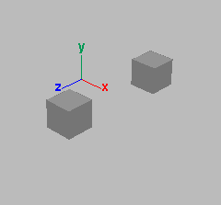
Instancing
A node may have more than one parent
A dagPath is used to identify instances
group1|pCube1|pCubeShape1
group1|pCube2|pCubeShape1

Slide 18
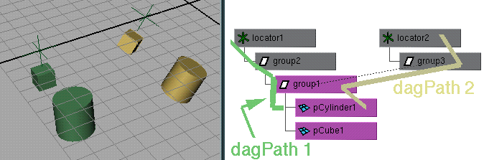
Dag Paths
used to find world space transformations
used to traverse up and down hierarchy
node names need not be unique if dagPaths are different (MDagPath fullPathName, partialPathName)

Slide 19
MObject VS. MDagPath
Many of the Maya API accept/return a MObject or a MDagPath
A MDagPath is a handle describing a path to a node
A MObject is a wrapper around a pointer to the internal Maya object
Generic class (represents all node / attribute)
Use apiType() / hasFn() to determine what it is or what you can do with it
Use isNull() to determine if it is a valid MObject
Do not store MObject

Slide 20
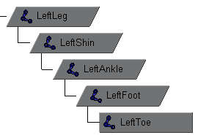
Important API methods
Traversal : MItDag iterator class
Depth in hierarchy: MDagPath::length, MItDag::depth
Getting the parent: MDagPath::pop
Local matrix: MFnTransform::transformation
World matrix: MDagPath::inclusiveMatrix, MDagPath::exclusiveMatrix …

Slide 21
Example: dagInfo
In this exercise, we will implement a custom command dagInfo. For all the selected DAG nodes in the scene, it will print out the instance information, dag path and also inclusive and exclusive matrix.
Important Classes: MFnDagNode, MDagPath MMatrix, MGlobal, MItSelectionList

Slide 22
Example: instanceRotate
manipulates the instances of a selected mesh shape by rotating them with a quarter angle every time. User can specify which axis they want the objects to move around by sending arguments to this command.
Practice note: how to handle complex plugs such as compound attribute plug
how to work with Msyntax, MArgParser and MArgDatabase and parse arguments
Notes:
Sometimes when you execute the command, it looks like the cylinders are not rotating, they are actually rotating, it is just the rotation angle this time is exactly the same as last time

Slide 23
Autodesk

